Slide 1
A Grid execution model for the ANSYS engineering simulation software
Alessandro COSTANTINI¹, Marco BENCIVENNI¹, Diego MICHELOTTO¹, Daniele CESINI¹, Emidio GIORGIO¹, Luciano GAIDO¹, Alberto MONETTI², Mattia MANZOLARO², Alberto ANDRIGHETTO²
¹ INFN/IGI, Viale Berti Pichat 6/2, Bologna (IT)
² INFN-LNL, Padova (IT)
alessandro.costantini@cnaf.infn.it

Slide 2
Summary
European Grid Initiative and IGI
The User Community: SPES@INFN
The computational problem
Code Porting: ANSYS
License handling
A smart solution: IGI web portal
Conclusions

Slide 3
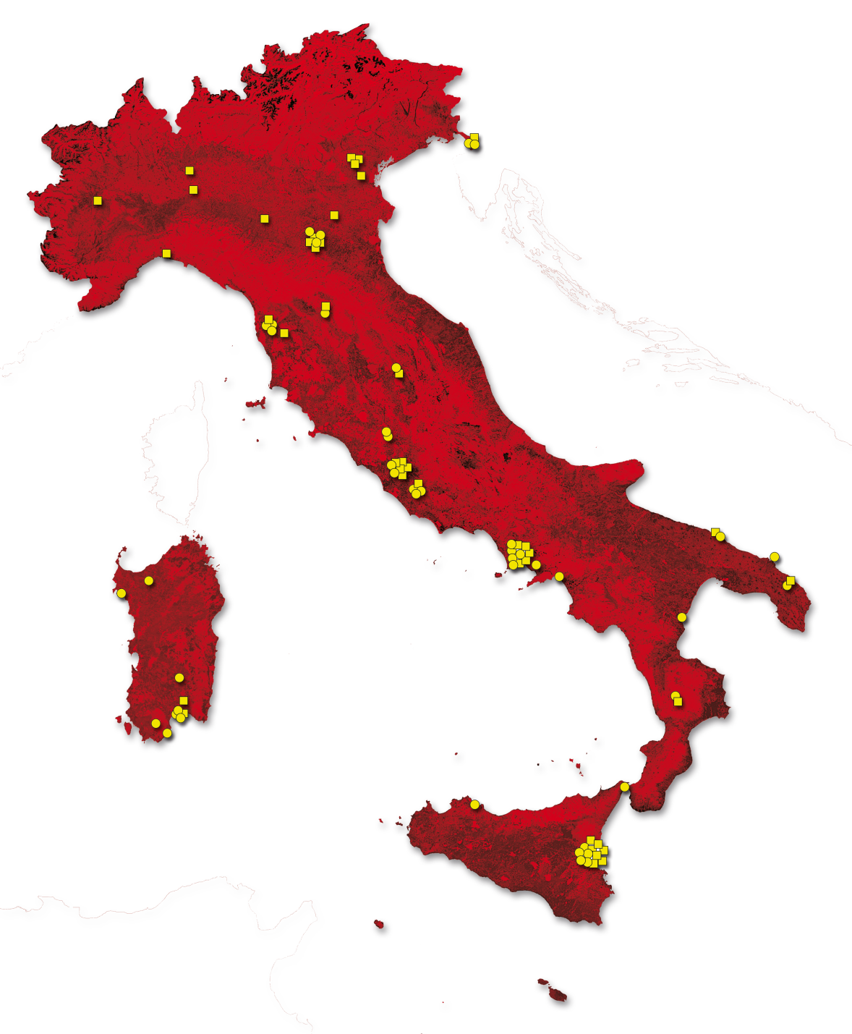
Work-plan for application porting
Seek, identify, and closely support new communities to deploy their applications and create the computing model
The NGI_IT
User
Support and
Formation
(FUS) team
Disseminate the work done to find new applications for long term sustainability
Train users to use the new execution procedure

Slide 4
The SPES project
SPES (Selective Production of Exotic Species) is a multi user project aimed at developing a Radioactive Ion Beam (RIB) facility covering interdisciplinary applied physics in the fields of material science and medical applications.
SPES is a project of the INFN Road Map for the Nuclear Physics development
@ INFN Legnaro National Laboratories, Italy
Research focused on the electro-thermal design of high temperature devices for the production of Radioactive Ion Beams

Slide 5
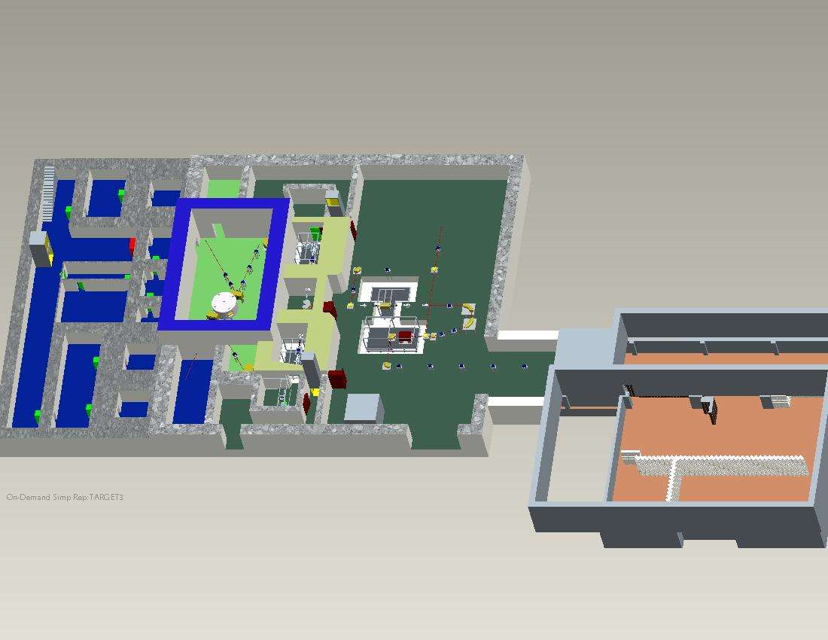
The SPES project at LNL
Facility layout
SPES Area
ISOL FACILITY
INTERDISCIPLINARY APLLICATIONS FACILITY
Existing Piave-Alpi building

Slide 6
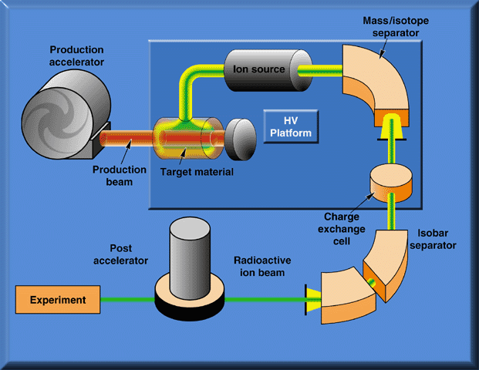
ISOL facility scheme
Breeder

Slide 7
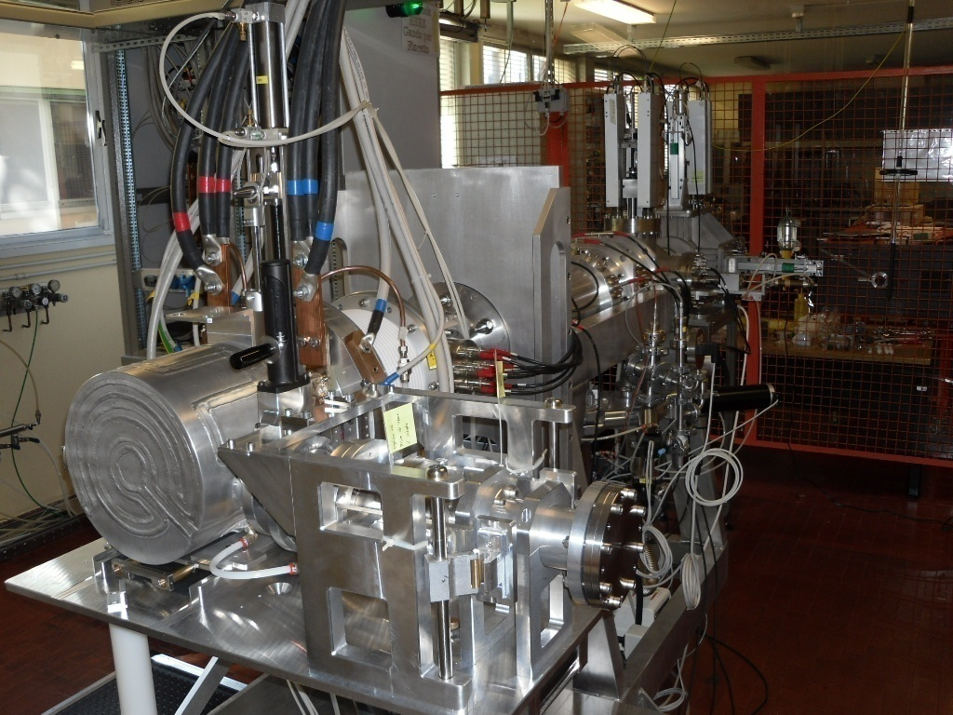
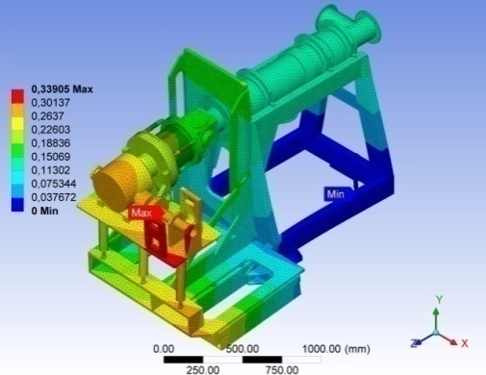
The scientific problem
Simulation modeling of a real experimental machinery apparatus
Target: evaluate the stability and the mechanical strength
Software used: ANSYS simulation suite

Slide 8
ANSYS simulation software
ANSYS suite is an engineering simulation software (computer-aided engineering, or CAE)
Offers a comprehensive range of engineering simulation solution sets (automotive, aerospace, energy, …)
Simulation Technology: Structural Mechanics, Multiphysics, Fluid Dynamics, Explicit Dynamics, Electromagnetics, Hydrodynamics
ANSYS offers different options for distributing model-solving power using multiple processors by using an embedded MPI communication layer

Slide 9
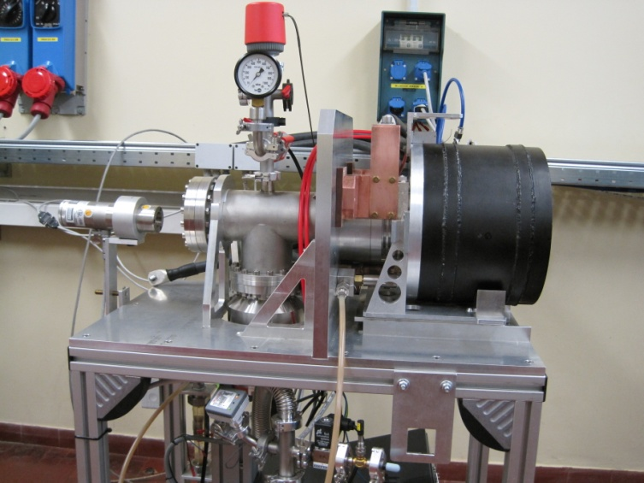
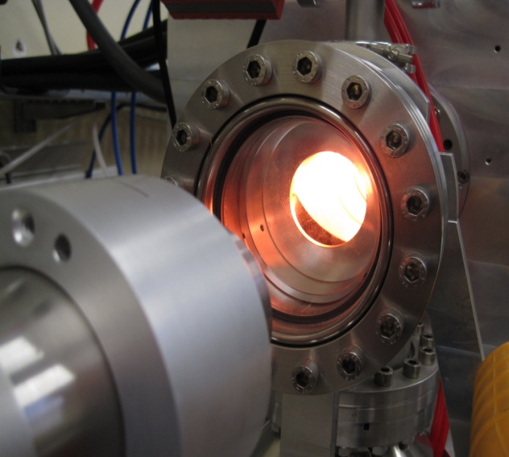
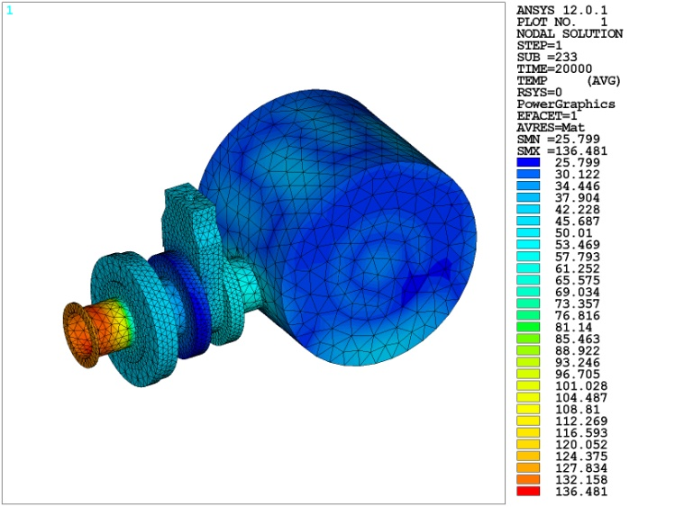
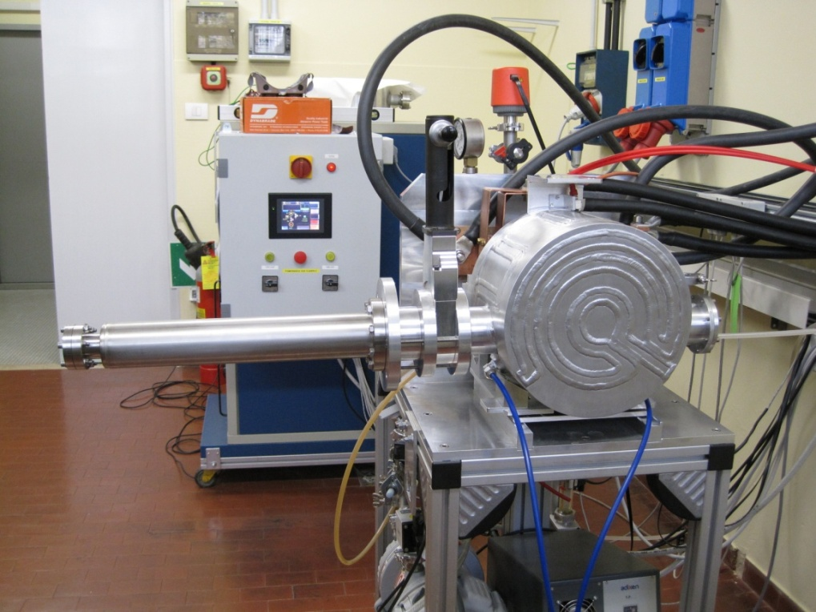
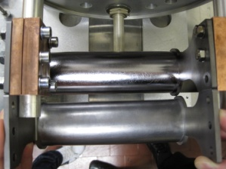
ANSYS calculation for the
SPES project
Pyrometer
FEM model
I =1300 A
P = 9 kW
T_{in} = 1850 °C
P = 9 kW !
T_{out} = 30 °C
Notes:
12/09/12
9

Slide 10
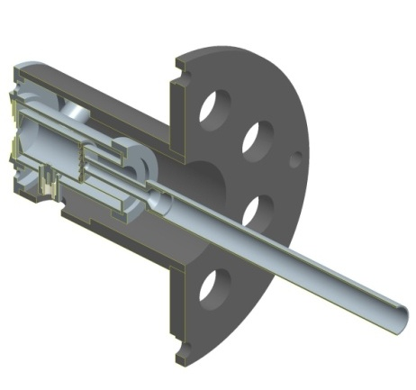
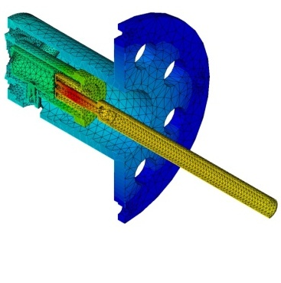
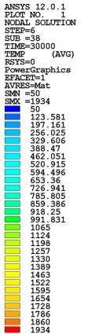
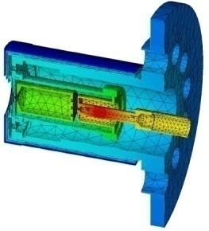
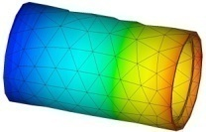
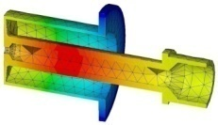
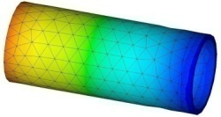
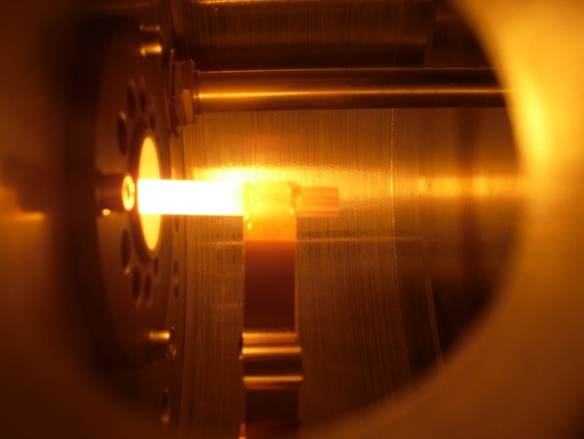
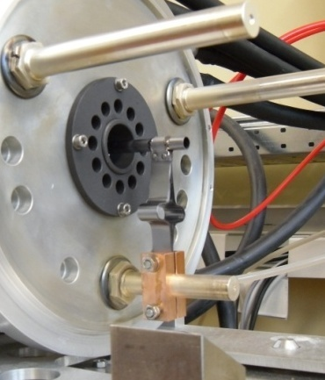
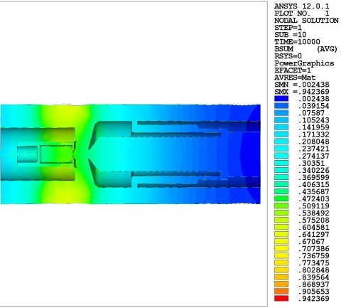
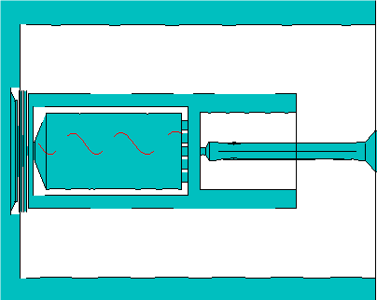
Ansys calculation for the
SPES project
1) Elettro-termo-struttural of the (Isolde) and (Hribf) FEBIAD
2) Comparison focused toward the new SPES FEBIAD
3) Validation of the FEM model
4) Study of the magnetic field using FEM
Notes:
12/09/12
10

Slide 11
The computational problem
ANSYS calculations performed by SPES can be treated as a series of independent computations
They require:
A set of multiprocessors (or multicore) resources
From hours to days of CPU time per computation
Storage area to save the results coming from the computations (few GB/calculation)

Slide 12
Application porting
ANSYS has been installed and configured in some Worker Nodes (WN) that belongs to the IGI domain, in a site located at CNAF on servers owned by the INFN
Both the installation and configuration have been carried out
Under Scientific Linux 5.7 O.S.
Using CLI procedures
WNs are accessed via batch system such as PBS or LSF

Slide 13
License handling
25 Research licenses shared among different INFN owners
WNs are located close (on the same site) of the Flex server (due to license restrictions)
WNs can be accessed only by INFN owners of the license
License handling mechanism has been presented to the Italian dealer for approval
Work in progress to implement a monitor usage mechanism

Slide 14
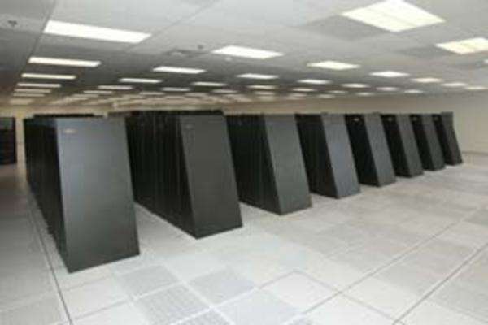
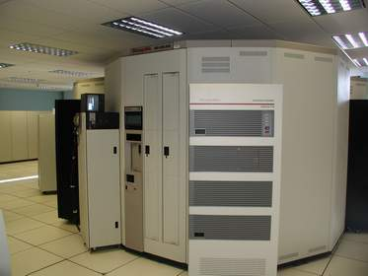

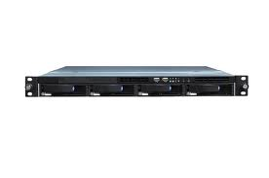



Access to the resources
ANSYS
Worker Nodes (WN)
Storage
Batch System (PBS,LSF…)
FLEX SERVER
Computing Element (CE)
Storage Element (SE)
Site BDII (sBDII)
UI
Personal Certficate
GROUP:
/GRIDIT/ANSYS
VOMS SERVER

Slide 15
The IGI Portal facility
IGI Portal is a powerful and easy to use gateway to access distributed computing and storage resources
Based on the WS-PGRADE application
The generic application structure is a workflow
Interface can be customized to support different user communities needs (GRIDIT, THEOPHYS, COMPCHEM, …)
A web GUI has been provided through a dedicated portlet
To access the standard functionalities of the Grid
To minimize the skills needed by the user to use the Infrastructure
IGI PORTAL Presentation
xxx

Slide 16
The typical usecase
User provides the initial input files and configuration parameters and waits for the results until the calculation is terminated
APDL (collection of ANSYS commands)
Input data
Needs
Several days of computations
Store GB of data for each computation
Check the consistency of the output at runtime

Slide 17
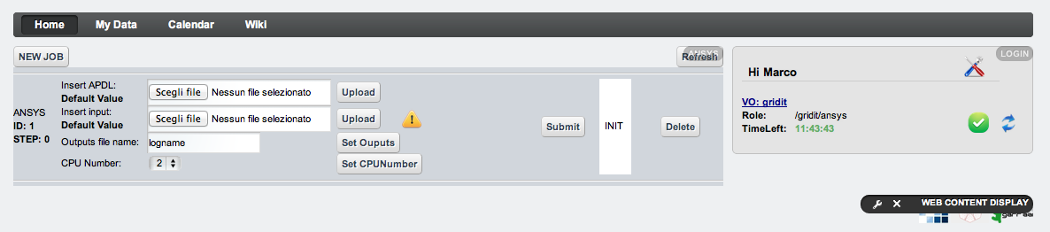
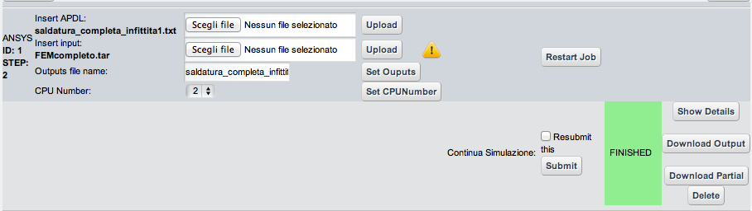
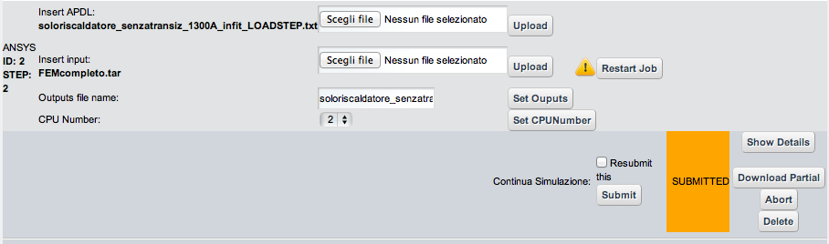
The ANSYS portlet

Slide 18
The adopted solutions
The evolution's audit
A crucial aspect of such long time simulations is the evolution's audit of the calculations at runtime
Use has been made of the SRM-Client functionalities that exploit Grid Storage Elements
temporary files and partial output are copied to the SE and made available for inspection at runtime
Exploiting the web-based features of the SRM-Server on the SE
All the files stored in the SE (temporary and permanent) can be accessed via web

Slide 19
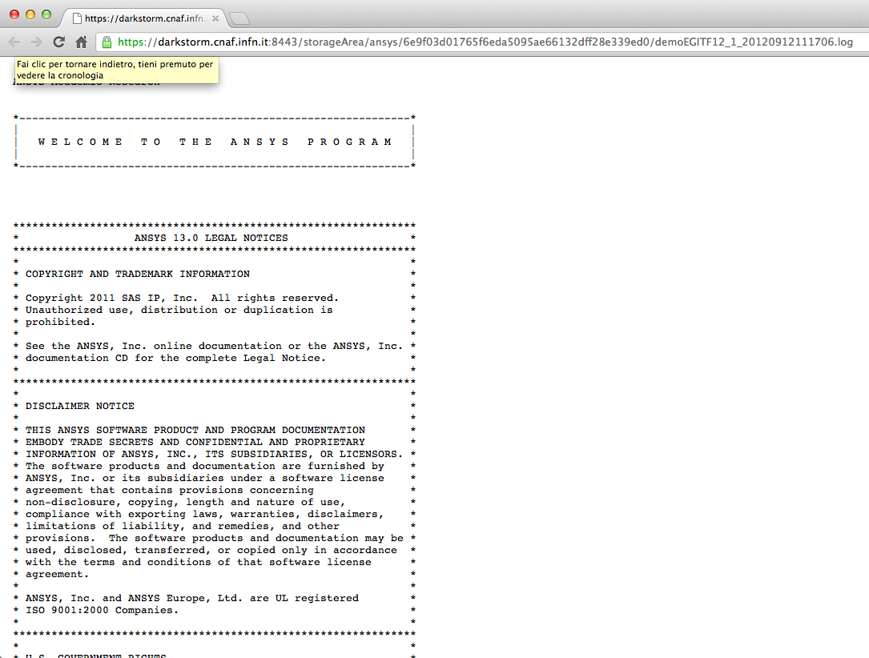
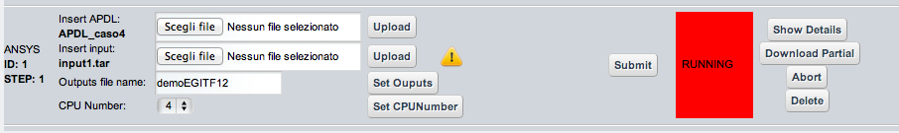
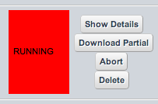
The adopted solutions

Slide 20
The adopted solutions
The computation time
Granted amount of CPU time is limited on Grid sites
From 6 hours to few days
Specialized script developed to handle the checkpoint of the calculation
set the computational environment needed for the application
monitor the computation time allowing a safely interruption of the application
The user have to submit a new calculation to continue his/her work if the granted CPU time is not enough

Slide 21
A step forward
Added value: the automatic workflow
The constantly grow of needs of the SPES community motivated us to develop a first prototypical workflow
Portlet and script work in a collaborative way to implement a complex SPES usecase
The workflow steps are conditioned by event-related dependences occurring at runtime

Slide 22
Conclusion
ANSYS was successfully ported to Grid services in strong partnership with the SPES community in order to address their requirements
To preserve license restrictions a strict control on access was implemented through Grid services
The adoption of a “web based ad-hoc solution” allows also inexperienced users to execute ANSYS on the Grid
Work in progress to build a solid platform, offered to users as a service, for assembling accurate multi scale realistic simulations and workflows
Implementation of a monitor usage mechanism

